Slide 1

Team Name : Spirit
Team Leader Name : Meghna Subramani
Problem Statement : Build an AI-powered solution that improves access to information, resources, or opportunities for communities and public systems.

Slide 2

Brief about the Idea:
The AI Emergency Help Assistant is a multilingual, voice-enabled, low-bandwidth AI system designed to support people during the first critical minutes of an emergency—before ambulances, police, or fire services arrive.
It detects emergencies automatically, identifies the type of emergency, and provides step-by-step first-aid guidance, while also helping users contact nearby emergency services and SOS contacts.
The solution is optimized for panic situations, rural or low-connectivity areas, and users with little medical knowledge.

Slide 3
Problem Definition
In real emergencies (collapse, accident, disaster):
People panic and forget basic first aid
Emergency numbers are not easily available
Users don’t know what details to tell responders
Existing apps are text-heavy, English-centric, and require stable internet

Slide 4
How different is it from any of the other existing ideas?
Existing Solutions | AI Emergency Help Assistant
Static emergency apps | Dynamic AI-driven guidance
General health chatbots | Emergency-only intelligence
English-first | Local language + Voice
Internet dependent | Low-bandwidth / offline fallback
No panic handling | Step-by-step calm coaching

Slide 5
How will it be able to solve the problem?
Detects emergency intent from voice/text
Classifies emergency type (medical, accident, disaster, threat)
Immediately switches to emergency mode (no long explanations)
Guides step-by-step actions (first aid, safety steps)
Fetches nearest emergency services
Prepares responder-ready information
Works offline if needed
This reduces panic, saves time, and improves survival probability.

Slide 6
USP(Unique Selling Proposition) of the proposed solution
“Life-saving guidance in the first 5 minutes, for anyone, anywhere.”
Emergency-first AI (not a general chatbot)
Voice-guided first aid coaching
Local language + cultural context
Works in low connectivity environments
Tells users what to say to emergency responder

Slide 7
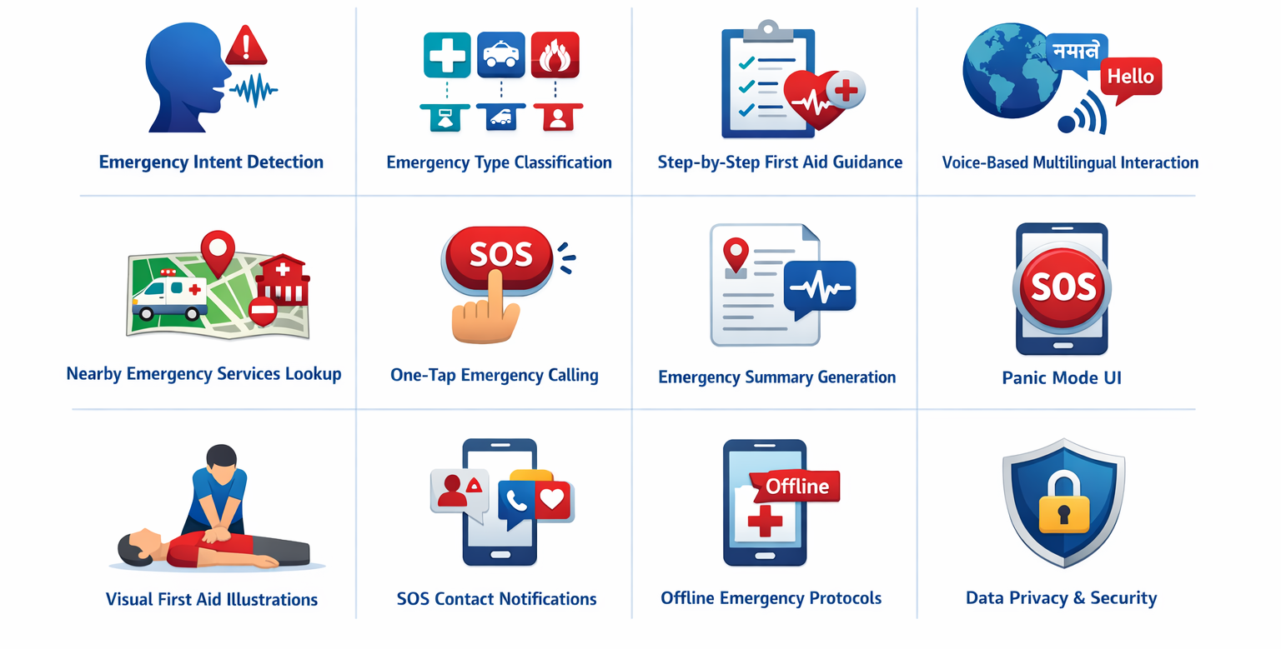
List of features offered by the solution

Slide 8
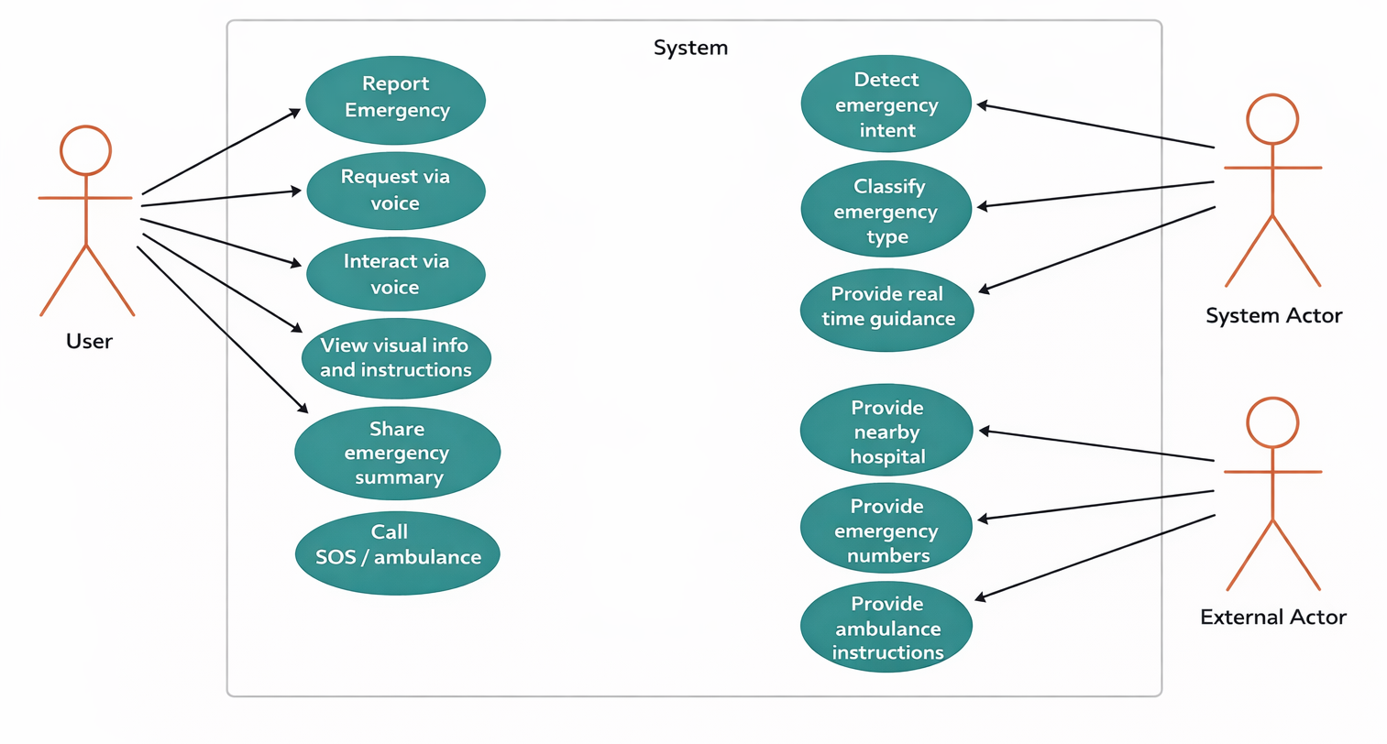
Process flow diagram or Use-case diagram – AI Emergency Assistant

Slide 9
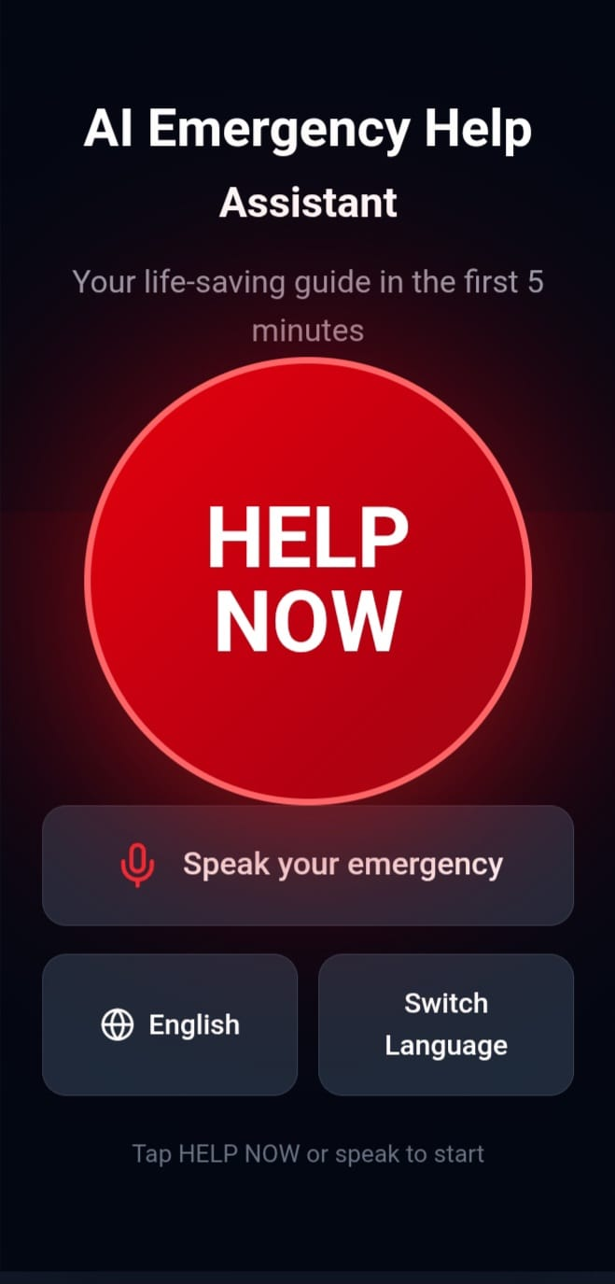
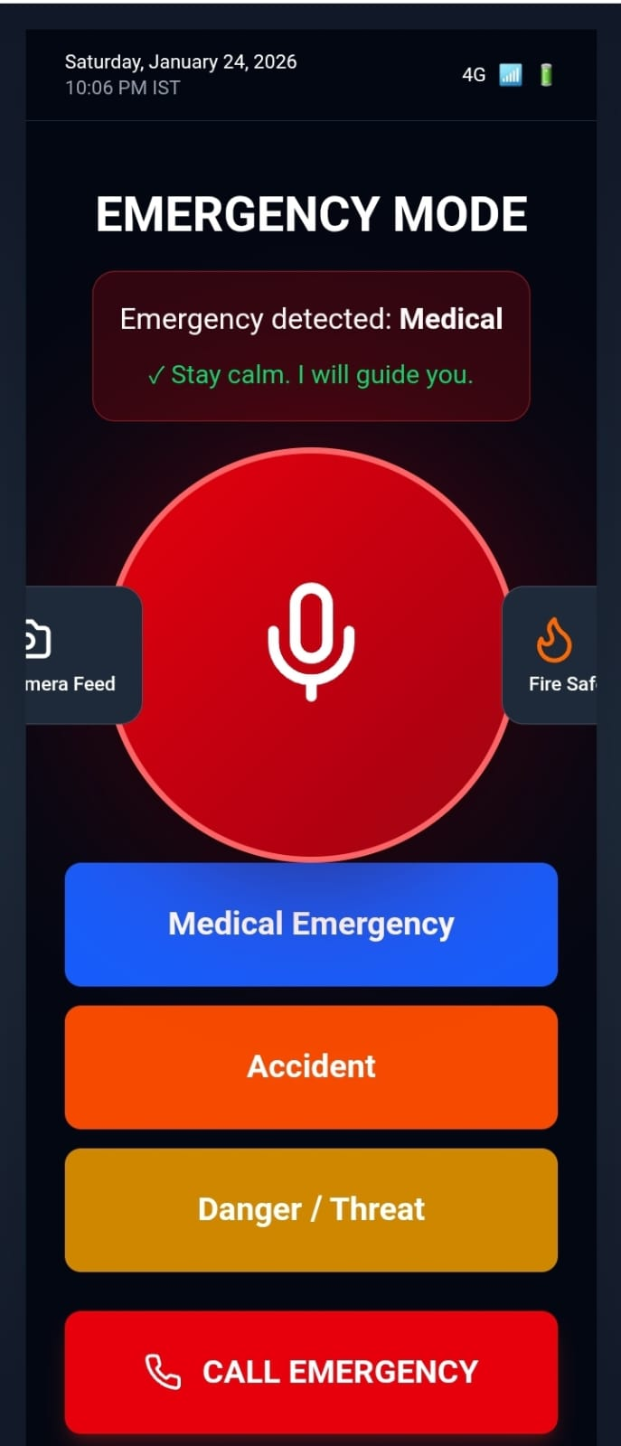
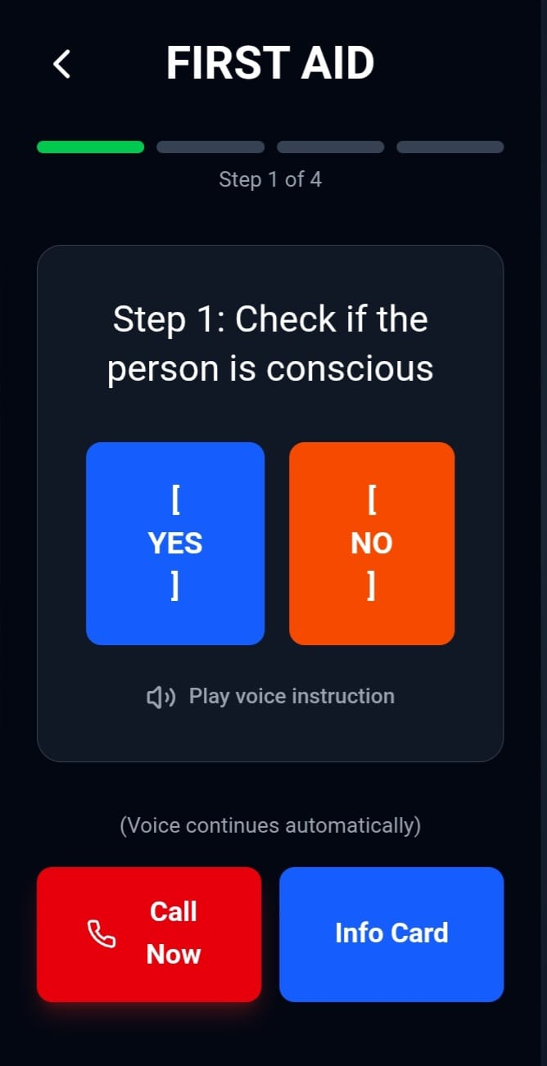
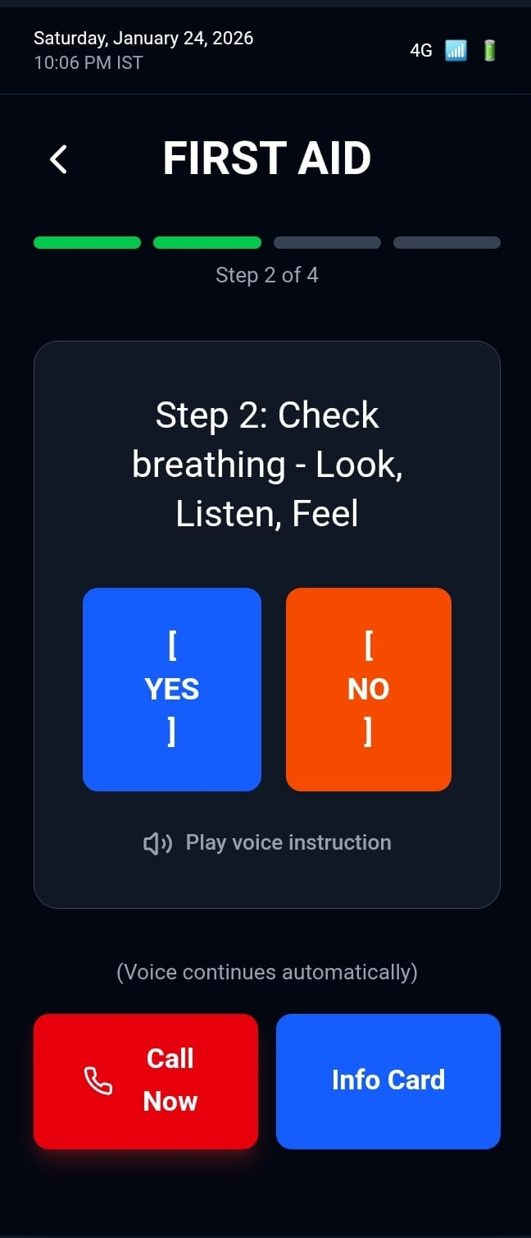
Wireframes/Mock diagrams of the proposed solution

Slide 10
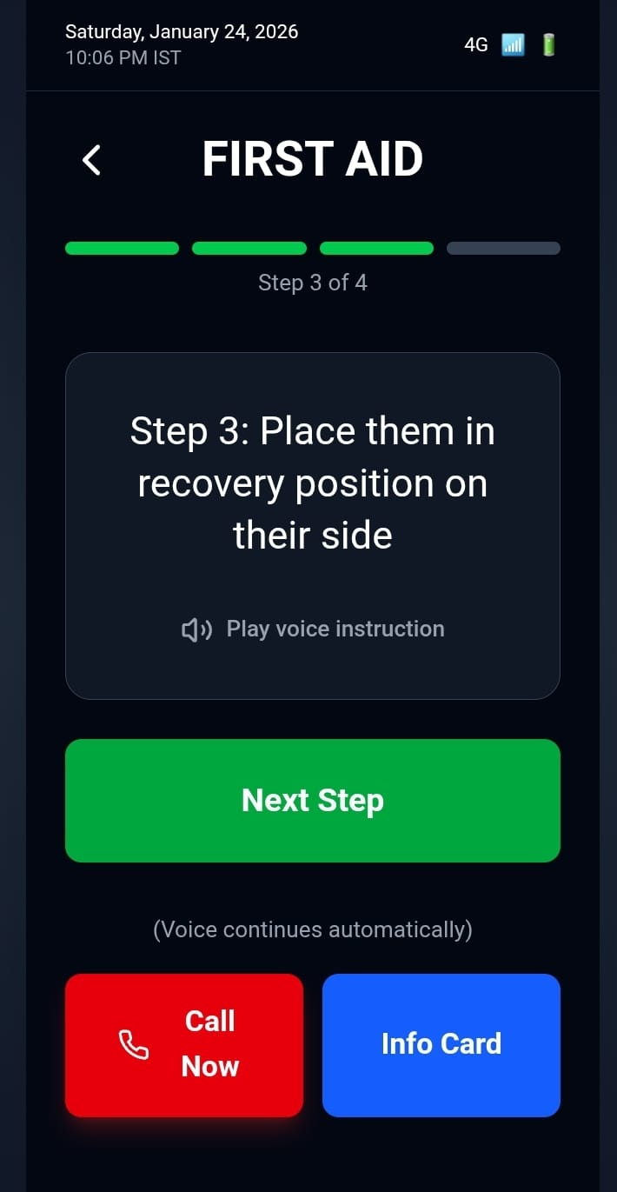
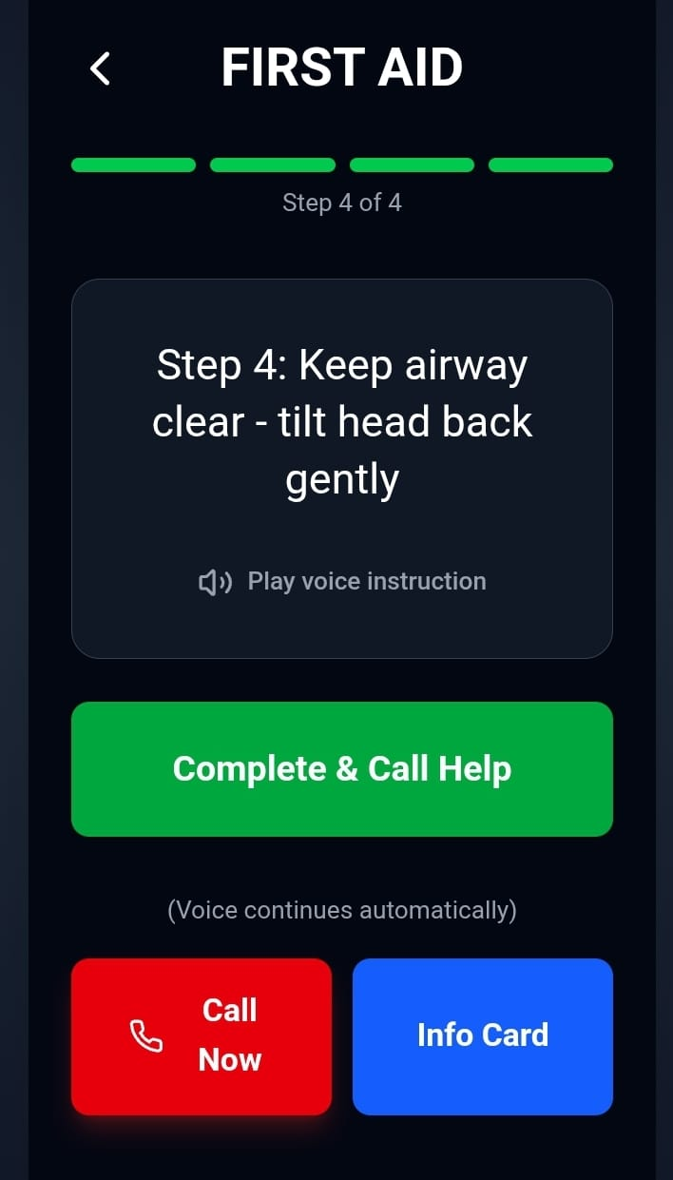
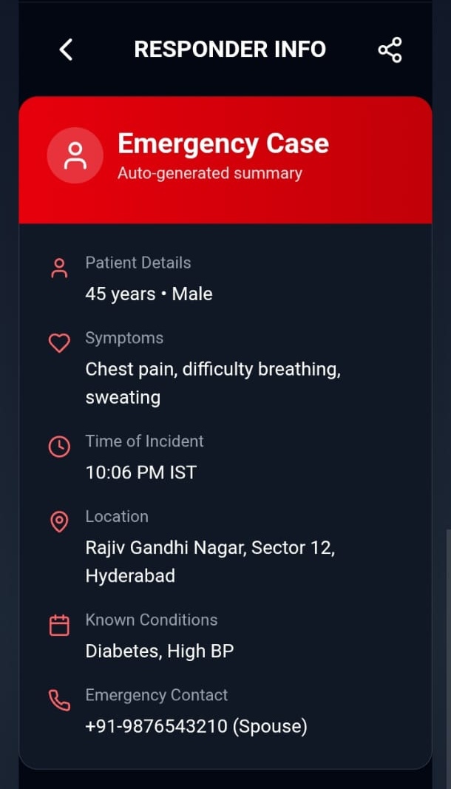
Wireframes/Mock diagrams of the proposed solution

Slide 11
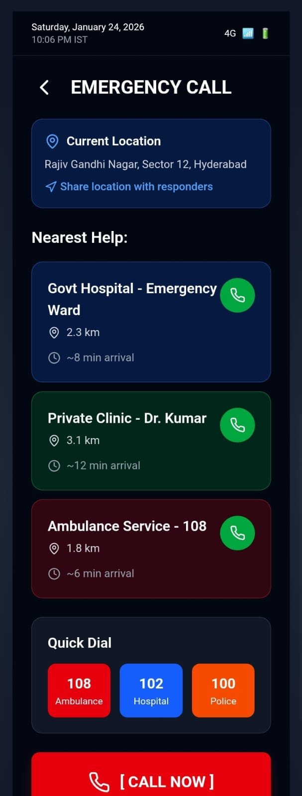
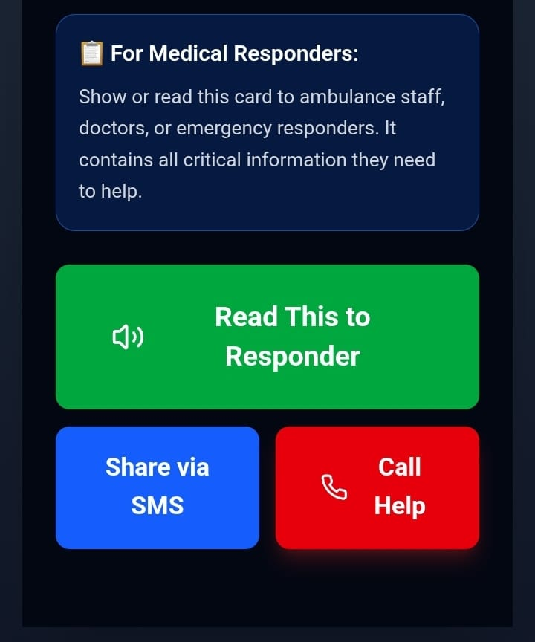
Wireframes/Mock diagrams of the proposed solution

Slide 12
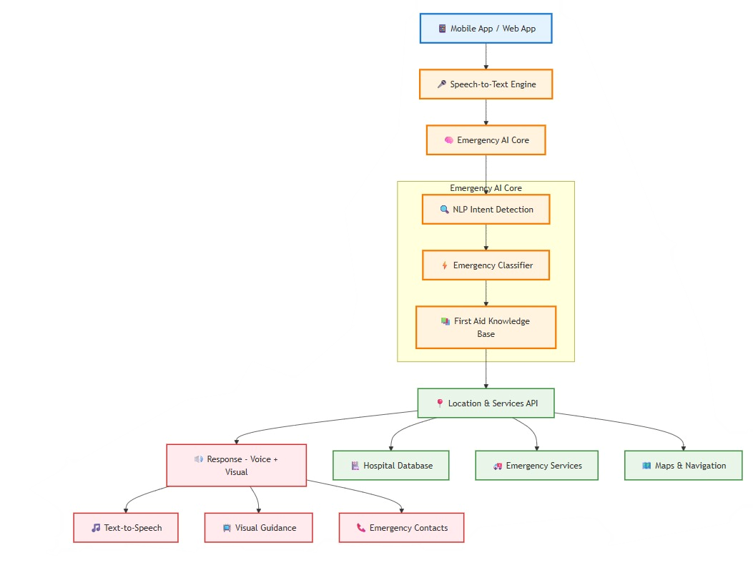
Architecture diagram:

Slide 13
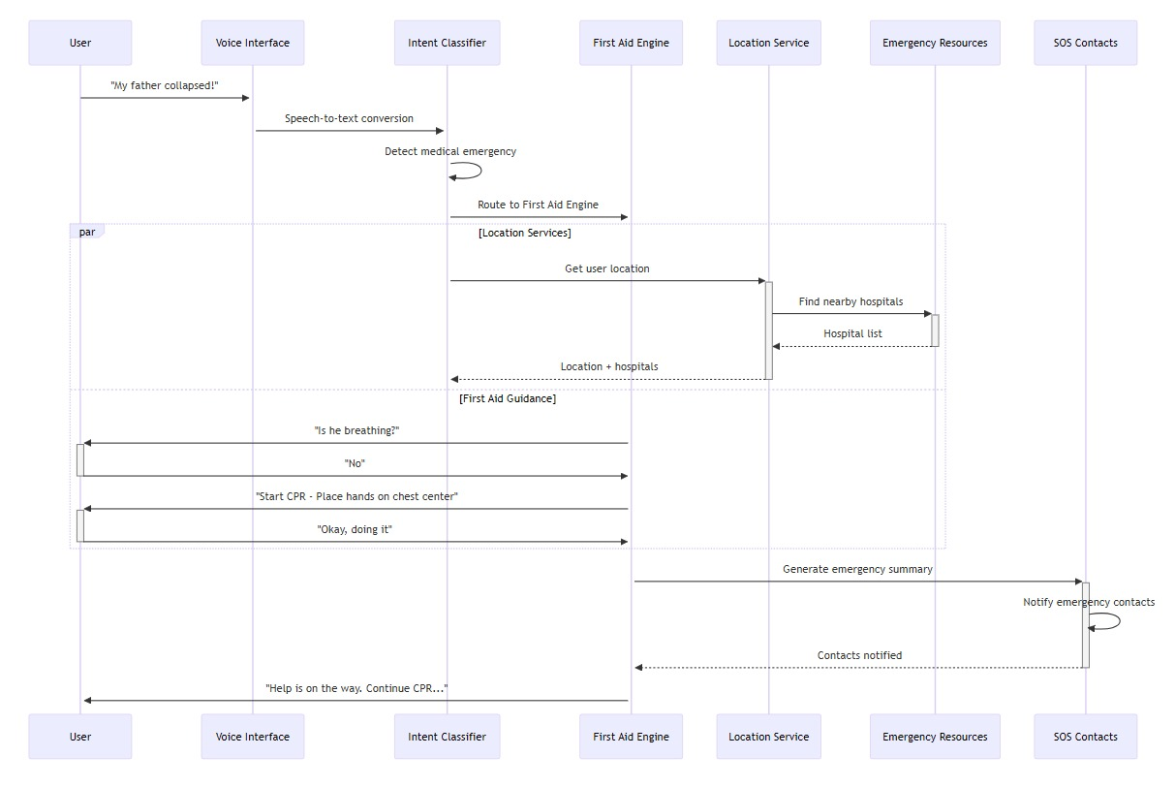
Sequence diagram:

Slide 14
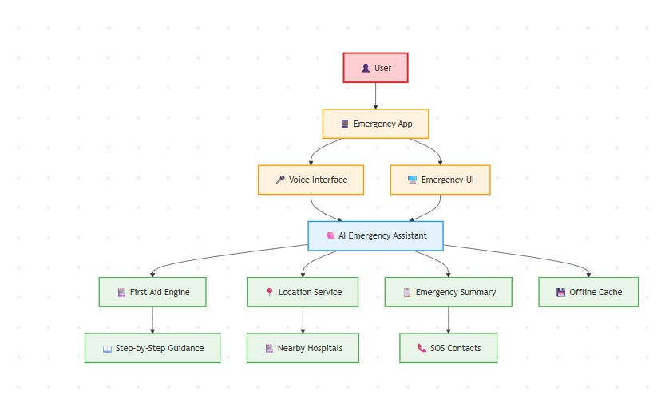
FlowChart diagram:

Slide 15
Target Users
Example User Flow
Rural & semi-urban populations
Elderly caregivers
Factory & construction workers
Women & children in safety threats
Disaster-prone communities
User: “My father collapsed”
AI Flow:
Detects medical emergency
Asks: “Is he conscious?”
Guides CPR or recovery position
Shows ambulance & hospital
Generates info card:
      Age
      Symptoms
      Time of incident

Slide 16
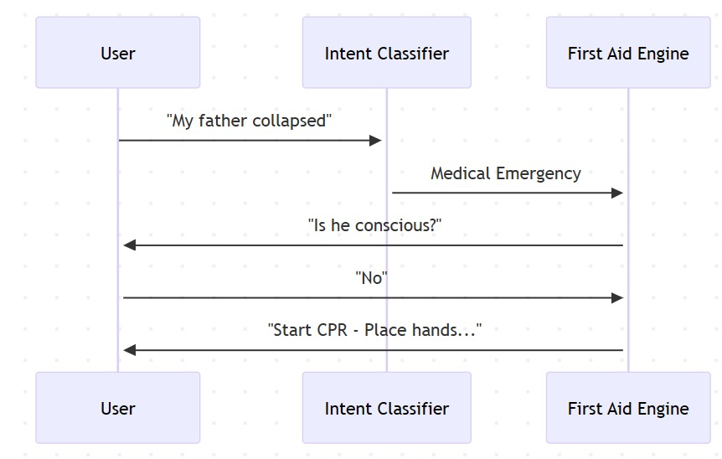
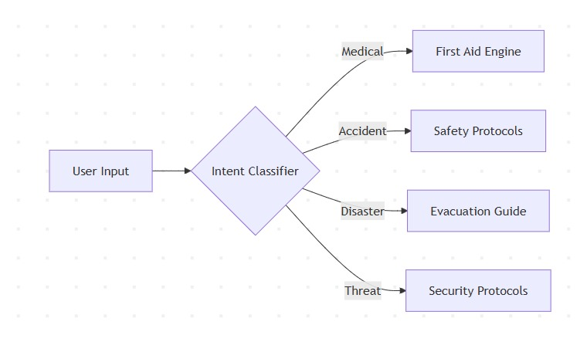
Sequence diagram:
Activity diagram:

Slide 17
Technologies to be used in the solution:
Frontend
Flutter / React Native
Android SDK
Accessibility UI Components
Backend
Python (Fast API)
Emergency Rules Engine
Vector DB for protocols
AI & ML
NLP intent classification
Speech-to-text(Google / Whisper)
Text-to-speech(Festival / Azure / Google)
Rule-based + ML hybrid for first aid logic
APIs
Maps & location services
Emergency contact database

Slide 18
Real-World Impact:
Saves lives in golden hour
Helps rural & underserved communities
Reduces panic-related mistakes
Supports emergency responders with clear summaries
Scalable nationwide

Slide 19


